Slide 1
Working Group on Calibration and Validation Land Product Validation subgroup
Introduction and Objectives
Fernando Camacho (EOLAB), Chair
Michael Cosh (USDA), Vice-chair
CEOS LPV Plenary Meeting, Teams – 26/05/2021

Slide 2
Welcome
Speakers
Philippe Goryl | ESA / WGCV
Valentina Boccia | ESA
Bruce Chapman | NASA JPL
Isabel Trigo | IPMA (EUMETSAT LSA SAF)
Roselyne Lacaze | HYGEOS (Copernicus GLS)
Eric Vermote | NASA
Tristan Goulden | BATTELLE (NEON)
Dario Papale | Tuscia U. (ICOS)
Christophe Lerebourg | ACRI (Copernicus GLS)
Joanne Nightingale | NPL (CCVS)
Invited
Ferran Gascón | ESA
Steffen Dransfeld | ESA
Fabrizio Niro | ESA
Jennifer Adams | ESA
Silvia Scifoni | ESA
Georgia Doxani | ESA
Kevin Ruddick | R. Belgian Inst for Natural Sci
Luke Brown | Southampton U.
Juan Pablo Arroyo | NRC-CNRC
Ray Soffer | NRC-CNRC
Benjamin Brede | Wageningen University
Martin Herold | Wageningen University
Ruben Urraca | EC JRC
Nadine Gobron | EC JRC
Christian Lanconelli | EC JRC
Caroline Toté | VITO
Jorge Sanchez | EOLAB
Hank Margolis | NASA
Michael Falkowski | NASA
LANCONETTI
Notes:
Current focus area leads are responsible for producing a validation protocol for their respective variables describing current methods and good practices within their respective communities. Some of these documents have been produced, and the following are in the pipeline:
Biomass protocol (contribution to CEOS CARBON strategy, CARB-16 and WGCV-19) under internal evaluation. Expected in Q4 2019.
Soil Moisture, Vegetation Indices, Land Cover, Active Fire and Phenology validation protocols are beginning development now. The objective is to have them ready for community review in about two years from now.
LAI protocol needs to be updated to cover new in-situ tools and good practices for high resolution products. The protocol document can also be updated to incorporate FAPAR as well. Expected for Q4 2021.
Surface Reflectance protocols need to be written. ESA is developing protocols for fiducial references and product validation under the FRM4Veg project. Similar exercises are being conducted by the Australian government. Moreover, the WGCV IVOS subgroup proposed that validation of surface reflectance to be subject of a new task force or extension of ACIX (IVOS R-2018-1). This is of strategic need also for LPV subgroup as surface reflectance is the input for most of our land products.

Slide 3
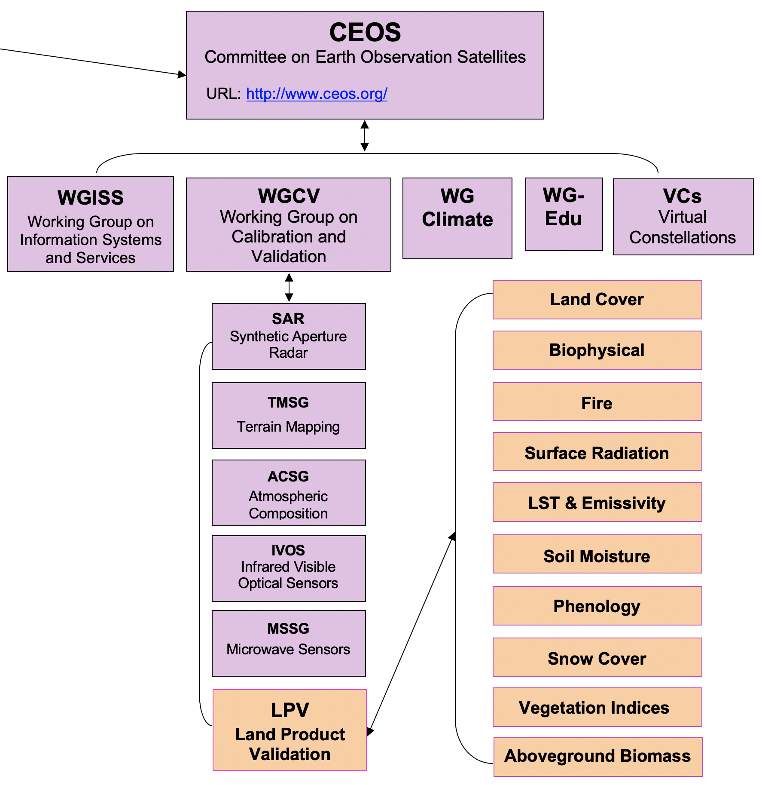
The CEOS WGCV LPV subgroup
Which satellite product better fits my needs?
www.ceos.org
CEOS – 62 Agencies operating 177 satellites!
CEOS was created to coordinate and harmonize Earth observations to make it easier for the user community to access and use data
The CEOS WGCV Land Product Validation (CEOS LPV) subgroup arose out of the recognition that standardized approaches to global product validation were essential for wide acceptance and use of global land satellite-based products
Notes:
The Land Product Validation subgroup arose out of the recognition in the late nineties that standardized approaches to global product validation were essential for wide acceptance and use of proposed global land products. Several programs at the time were aimed at global monitoring of Earth processes, many with plans to distribute higher level data products. A common approach to validation would encourage widespread use of validation data, and thus help us to move toward standardized approaches to global product validation. With the high cost of in-situ data collection, the potential benefits from international cooperation are considerable and obvious.
Hablar un poco mas de la introducción.
Decir que el CEOS y WGCV lo presentara Philip

Slide 4
CEOS LPV Objectives
To foster and coordinate quantitative validation of global land products derived from remotely sensed data, in a traceable way, and to relay results to users.
To increase the quality and efficiency of global satellite product validation by developing and promoting international standards and protocols for:
Field sampling
Scaling techniques
Accuracy report and use
Data and information exchange
To improve quality of ground references used for product validation
Field campaigns for fiducial references
Identification of sites and supersites for validation
To provide feedback to international structures for:
Requirements on product accuracy and quality assurance
Terrestrial ECV measurement standards
Notes:
Current focus area leads are responsible for producing a validation protocol for their respective variables describing current methods and good practices within their respective communities. Some of these documents have been produced, and the following are in the pipeline:
Biomass protocol (contribution to CEOS CARBON strategy, CARB-16 and WGCV-19) under internal evaluation. Expected in Q4 2019.
Soil Moisture, Vegetation Indices, Land Cover, Active Fire and Phenology validation protocols are beginning development now. The objective is to have them ready for community review in about two years from now.
LAI protocol needs to be updated to cover new in-situ tools and good practices for high resolution products. The protocol document can also be updated to incorporate FAPAR as well. Expected for Q4 2021.
Surface Reflectance protocols need to be written. ESA is developing protocols for fiducial references and product validation under the FRM4Veg project. Similar exercises are being conducted by the Australian government. Moreover, the WGCV IVOS subgroup proposed that validation of surface reflectance to be subject of a new task force or extension of ACIX (IVOS R-2018-1). This is of strategic need also for LPV subgroup as surface reflectance is the input for most of our land products.

Slide 5
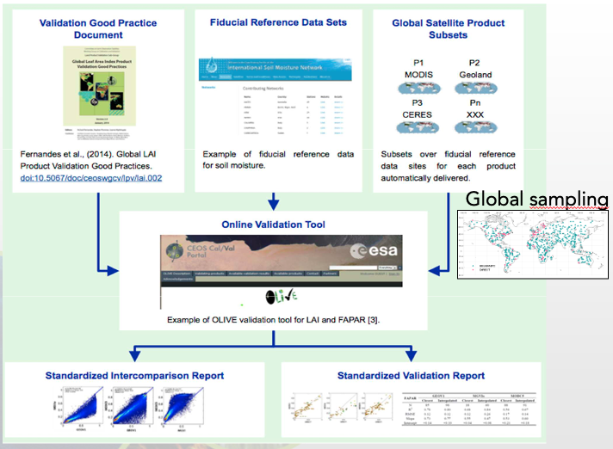
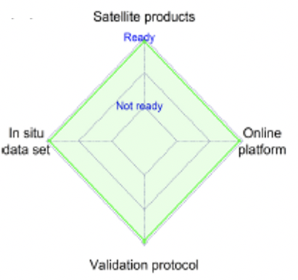
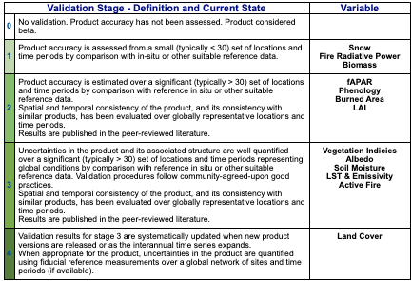
LPV Validation Operational Framework

Slide 6
LPV Strategy
LPV Strategy (2019-2022) agreed in Milan 2019 : https://lpvs.gsfc.nasa.gov/LPV_Meetings/LPV_plenary2019.html
Continuous Development of Good Practices Protocols
Improving ground references: data, sites, uncertainties
Promoting validation and intercomparison exercises
Improving LPV communication
Notes:
Current focus area leads are responsible for producing a validation protocol for their respective variables describing current methods and good practices within their respective communities. Some of these documents have been produced, and the following are in the pipeline:
Biomass protocol (contribution to CEOS CARBON strategy, CARB-16 and WGCV-19) under internal evaluation. Expected in Q4 2019.
Soil Moisture, Vegetation Indices, Land Cover, Active Fire and Phenology validation protocols are beginning development now. The objective is to have them ready for community review in about two years from now.
LAI protocol needs to be updated to cover new in-situ tools and good practices for high resolution products. The protocol document can also be updated to incorporate FAPAR as well. Expected for Q4 2021.
Surface Reflectance protocols need to be written. ESA is developing protocols for fiducial references and product validation under the FRM4Veg project. Similar exercises are being conducted by the Australian government. Moreover, the WGCV IVOS subgroup proposed that validation of surface reflectance to be subject of a new task force or extension of ACIX (IVOS R-2018-1). This is of strategic need also for LPV subgroup as surface reflectance is the input for most of our land products.

Slide 7
Continuous Development of Validation Good Practices
2014
2018
2019
2020
2021
Notes:
Summary of Achievements :
Good Practices
In-situ data / networks
Supersites – open / geographical gaps
Communication

Slide 8
Ground references: data, sites, uncertainties
CEOS LPV Supersite
Super characterized (canopy structure and bio-geophysical variables) site following well- established protocols useful for the validation of satellite land products (at least 3) and for radiative transfer modeling approaches.
Active, long-term operations, supported by appropriate funding
Supported by airborne LiDAR and hyperspectral acquisitions (desirable).
CEOS LPV Supersite and Biomass validation workshop
TERN, ICOS willing to adapt their protocols to fit better validation needs
Collaborative actions between networks and services (TERN-GBOV) to deploy new instrumentation in Supersites
If you are maintaining a validation site useful to validate one or more LAND products, please contact:
Fernando.Camacho@eolab.es
We need to expand the spatial coverage of our supersite network!
https://lpvs.gsfc.nasa.gov/LPV_Supersites/LPVsites.html
Notes:
Teleco to coordinate FLEX, FRM4VEG, EC GBOV, DATE
ESA FRM4Veg to set up 2 permanent site based on CEOS LPV supersites
GBOV instrumenting new supersites (Valencia AS)
LIST OF POTENTIAL SITES
MAXIMIZE THE INTEREST OF AGENCIES
NEED FOR INCREASING COVERAGE

Slide 9
BRIX-2: 2nd Biomass Intercomparison Exercise
Validation and Intercomparison Exercises

Slide 10
LPV Communication
Annual Newsletters (email)
Bimonthly telecons reports (Web)
Up-to-date Web / list of products / key references
Workshops or special sessions per variable (every 2-3 years)
Plenary LPV meeting (every 2 years)

Slide 11
Meeting Objectives
The main objective is to review the CEOS LPV action plan and shape the way forward.
Specific objectives are:
Hear reports from CEOS agencies and operational services on product validation,
Hear activity reports from CEOS LPV focus areas,
Discuss the status of good practices validation protocol,
Report on current validation and intercomparison activities,
Hear updates on fiducial reference data collection and ground networks,
Assess the readiness of operational validation systems for land products
Identify relevant actions and recommendations for the WGCV and CEOS WP 2022-2025,
Exchange information and promote synergies among key actors in the land product validation community.

Slide 12
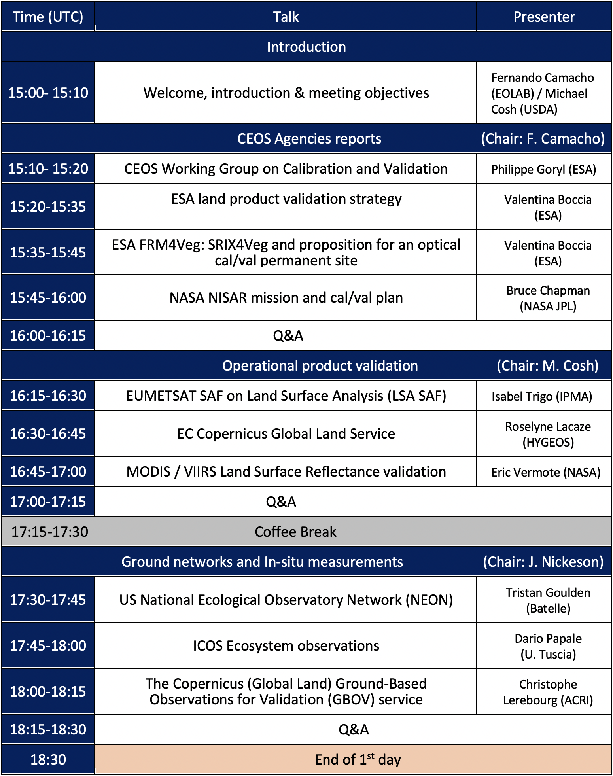
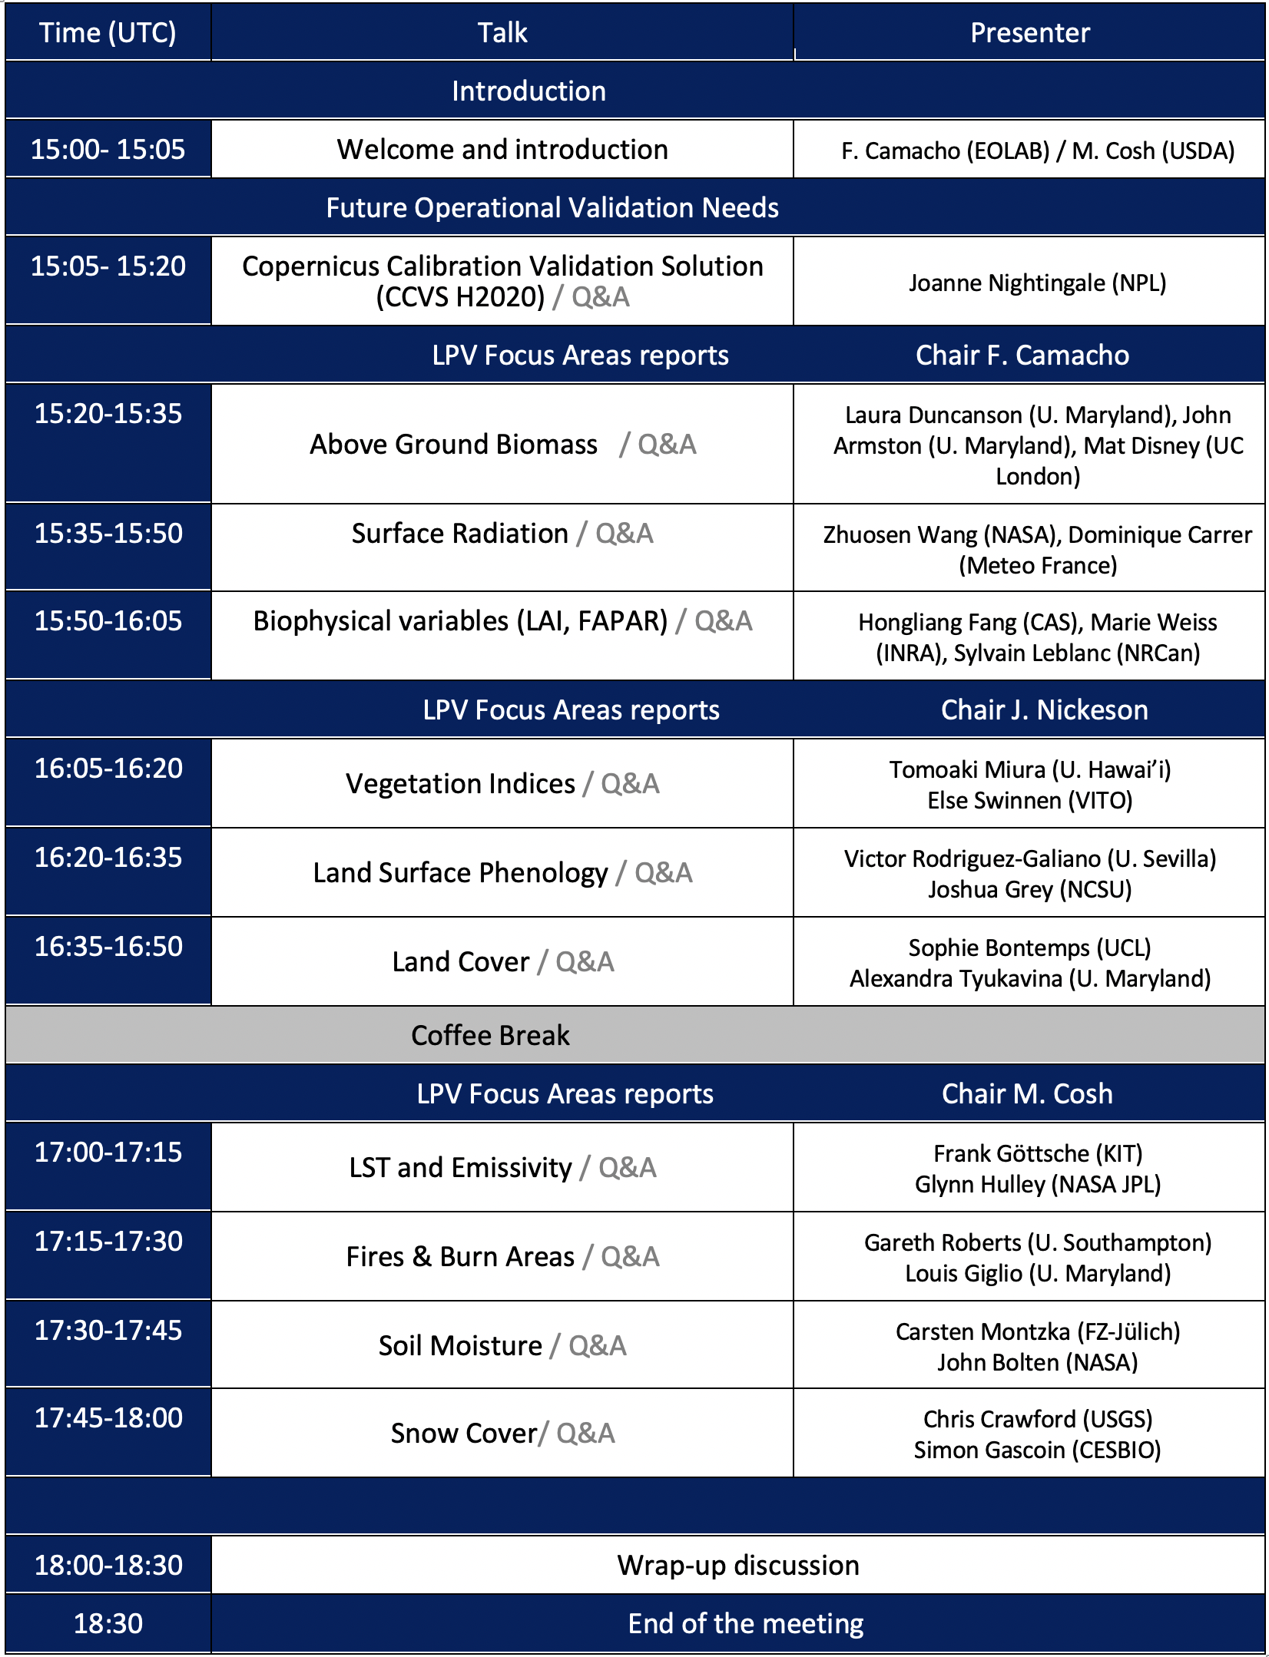
Meeting Agenda

